Slide 1
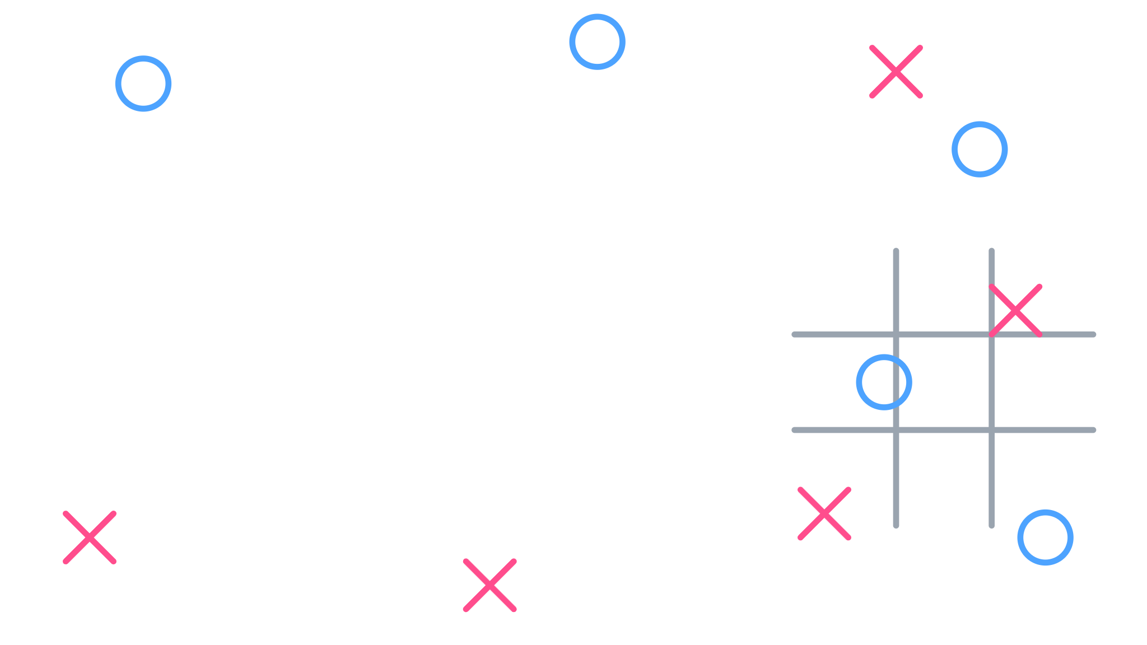


Classic Two-Player Tic-Tac-Toe Game
🎮 SOFTWARE ENGINEERING PROJECT PRESENTATION
Modular Architecture | Clean Input Validation | Real-Time Rendering
Team Agile Avengers
Members: Muntasir Mamun Fahim · S.M. Nahiyan Rahman Akib · Bishal Saha · Ishtiaq Ahmed
Course: CSE 115.4 Programming Language
Group 2 | Muntasir Mamun Fahim · S.M. Nahiyan Rahman Akib · Bishal Saha · Ishtiaq Ahmed

Slide 2



Always a draw
DID YOU KNOW?
255,168
possible Tic-Tac-Toe games fit on just 9 squares.
5,478
legal board positions
when both players play perfectly
Group 2 | Muntasir Mamun Fahim · S.M. Nahiyan Rahman Akib · Bishal Saha · Ishtiaq Ahmed
Notes:
Hook slide: ask the audience how many games they think are possible before revealing the number.

Slide 3
Project Overview & Core Features
A console-based, two-player game: X and O take turns on a 3x3 grid until someone wins or the board fills.
1. Modularity
2. Input Validation
3. Real-Time Rendering
Separate functions for board setup and display, move handling, win/tie logic and the game loop.
Blocks out-of-range choices and occupied tiles before the board changes.
The board is redrawn instantly after every move, so feedback is immediate.
Group 2 | Muntasir Mamun Fahim · S.M. Nahiyan Rahman Akib · Bishal Saha · Ishtiaq Ahmed

